Slide 1
IPF Connect/HRCT Demonstration
Miracle Advance Technologies co. ltd.

Slide 2
Introduction

Slide 3
Features
Login
Own Worklist
Assigned Worklist
Assessment Value
Radiologist Assign
Interpretation Result
Conclusion Result

Slide 4
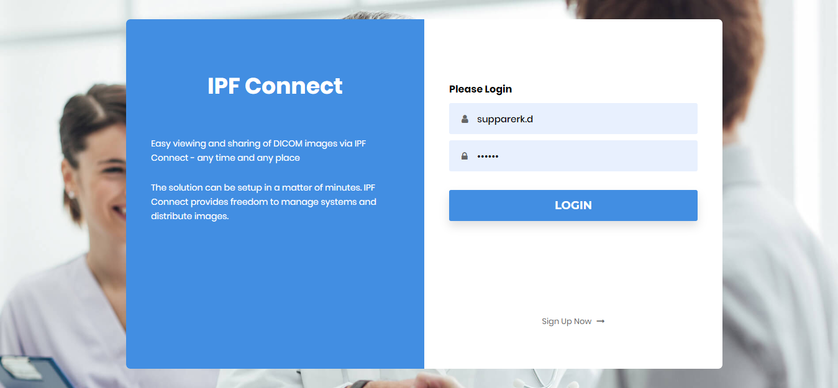
Present
Login

Slide 5
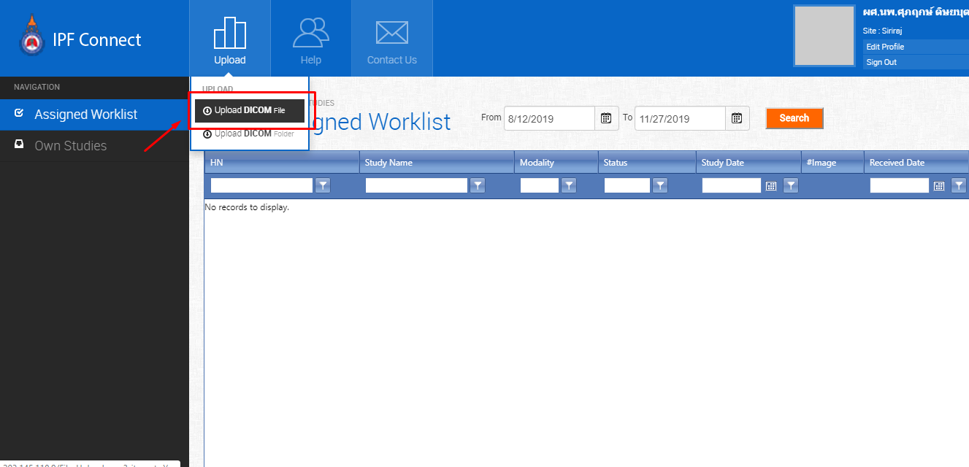
Present
Upload Dicom image from file or folder

Slide 6
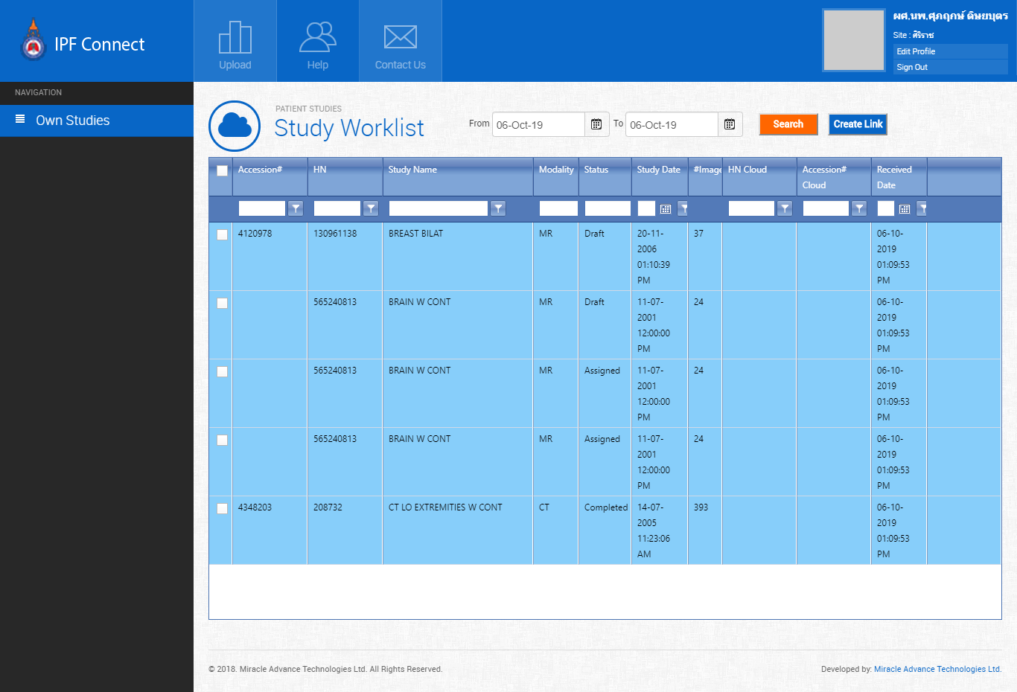
Present
Study Worklist

Slide 7
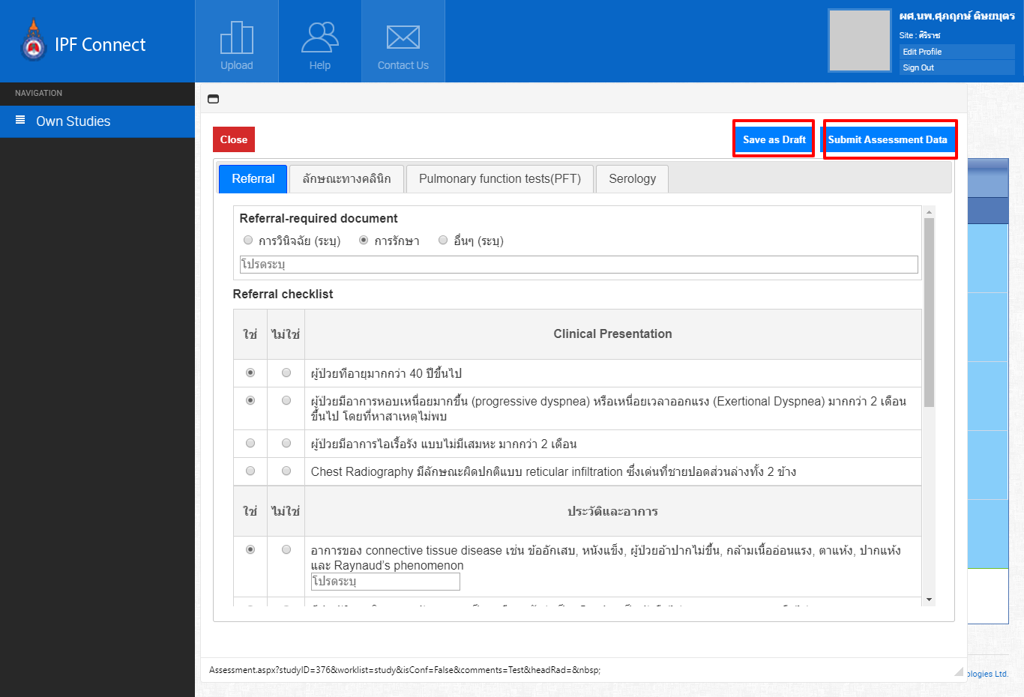
Present
Assessment Value entry

Slide 8
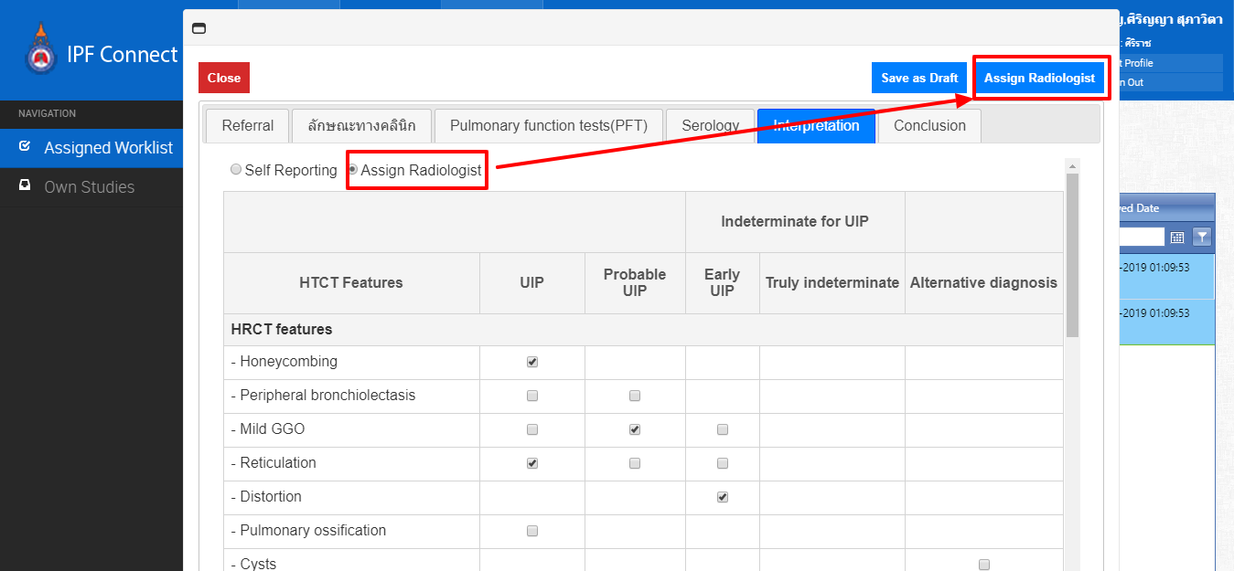
Present
Assign Radiologist
Source user or Admin user can able to assign radiologist.

Slide 9
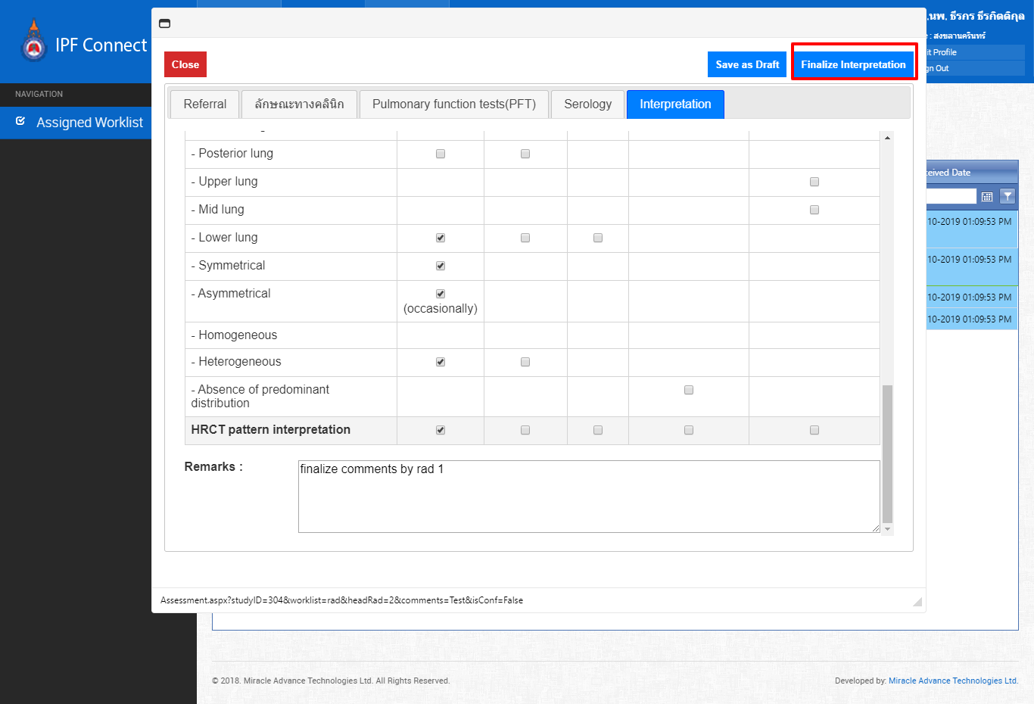
Present
Result entry

Slide 10
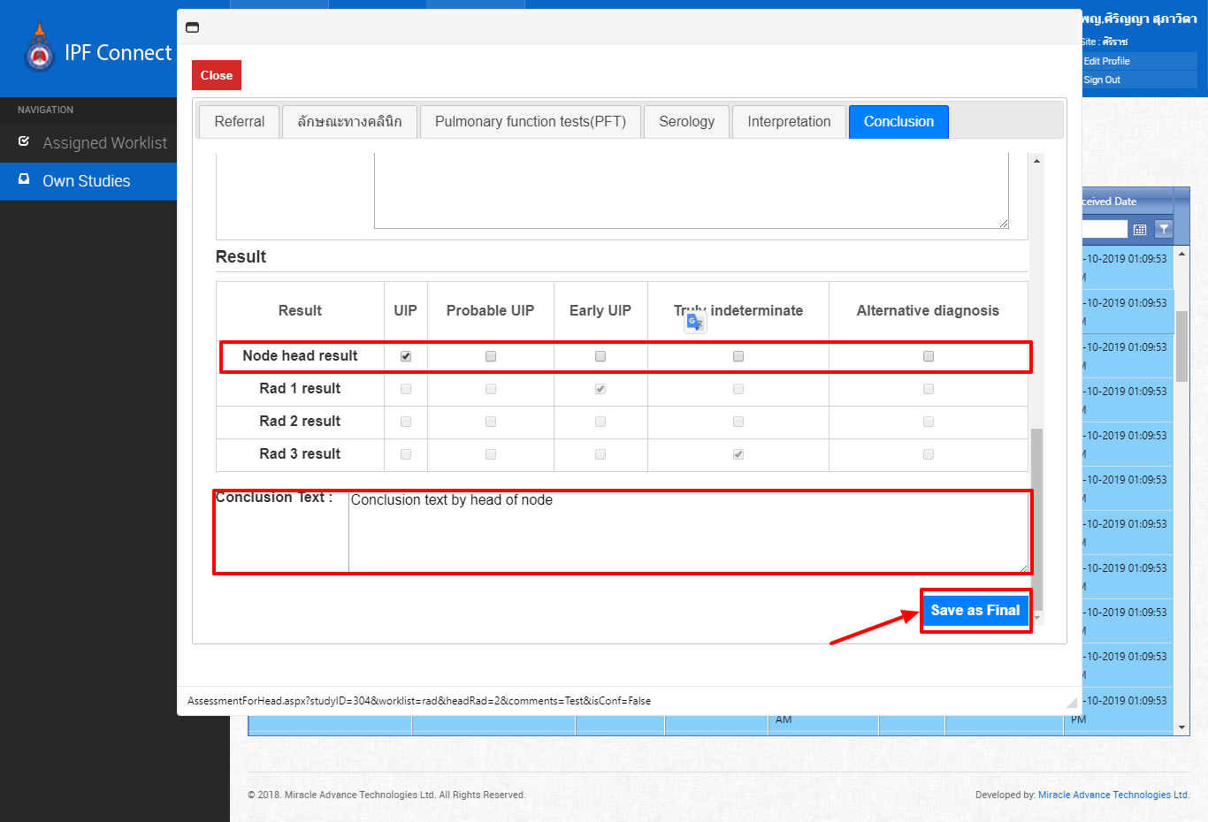
Present
Result entry

Slide 11
Thank You
Thank you everyone for your time.

